Slide 1
Metaverse
Muhammad Zubair

Slide 2
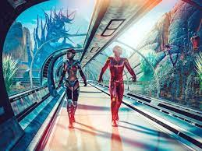

Metaverse meaning
a virtual-reality space in which users can interact with a computer-generated environment and other users.

Slide 3
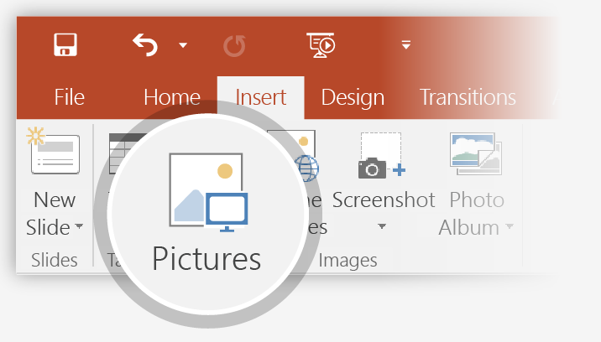
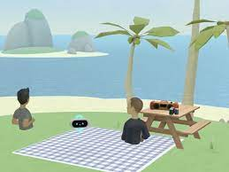
Metaverse in simple worlds
Imagine a virtual world in which people live, work, shop and interact with others -- all from the comfort of their couch in the physical world. This is known as the metaverse

Slide 4
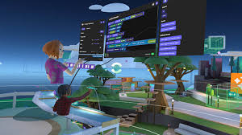
Metaverse another world
Parallel universes in fiction: A parallel universe, also known as a parallel dimension, alternate universe, or alternate reality, is a hypothetical self-contained plane of existence, co-existing with one's own.

Slide 5
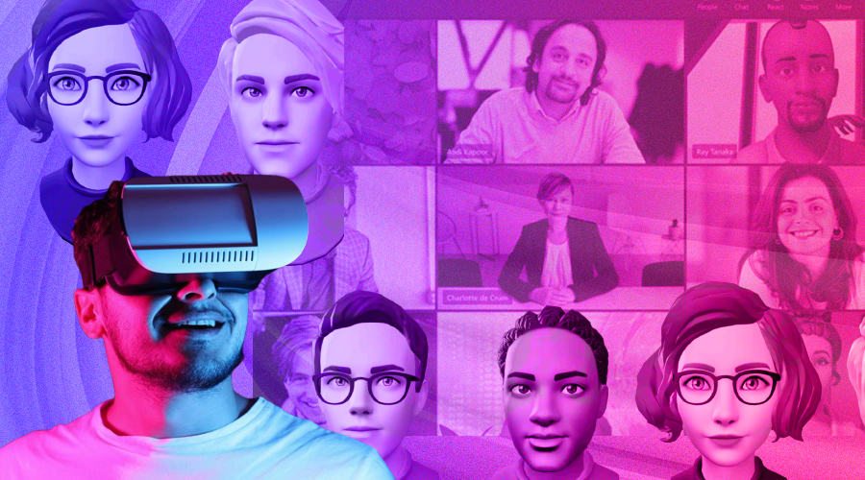
Metaverse change the world
The metaverse, by offering a 3D environment, has hopes of being the virtual environment for these social moments. Employees of the same company spread across the globe will have the potential to meet up in the metaverse to brainstorm at highly creative levels so as to solve problems

Slide 6
Metaverse user
3D owner
Teachers
Shopkeeper
player
.

Slide 7
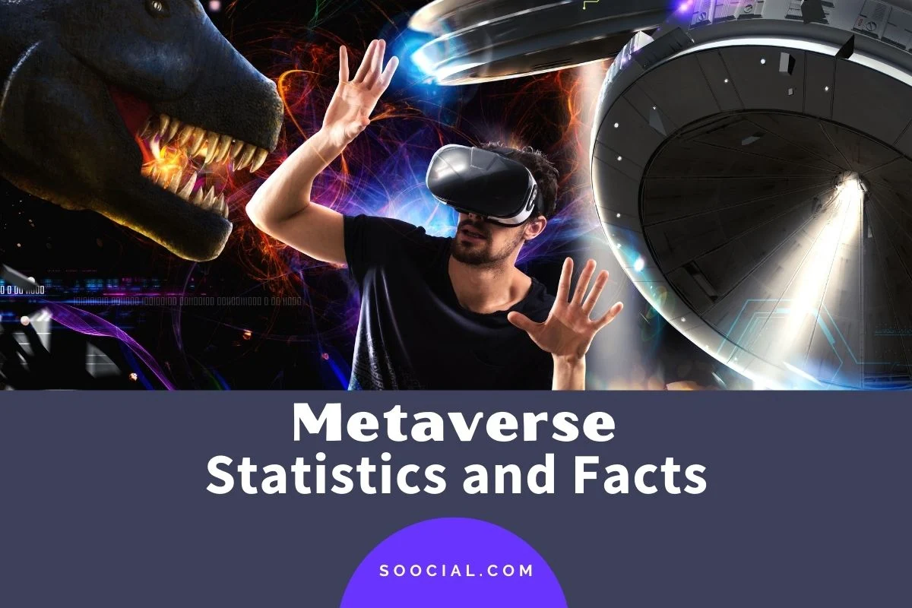
Meta verse statistics
The metaverse is where billions of people will spend their time online in the future. It will be a vast digital landscape incorporating social networking, entertainment, shopping, business, education, gaming, and virtually everything else that we do on the Internet today. It is a shared space that blends the virtual and real worlds. It will grow beyond games into an open platform for everyone and will be the place where we work, socialize and play.

Slide 8
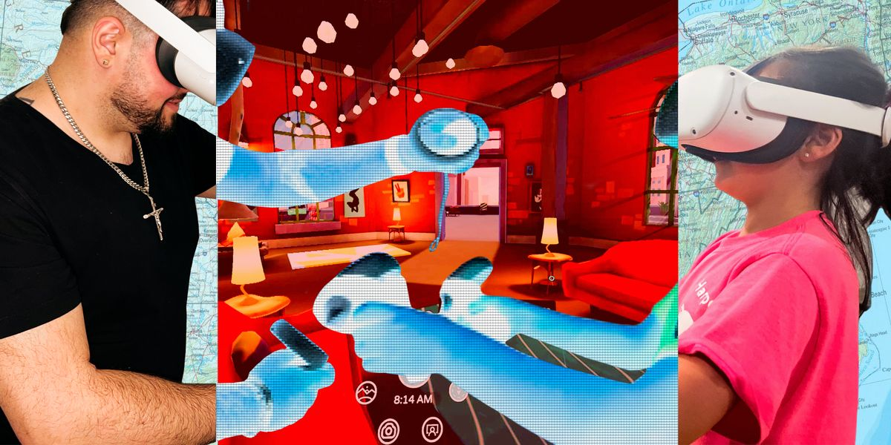
Metaverse connected

Slide 9
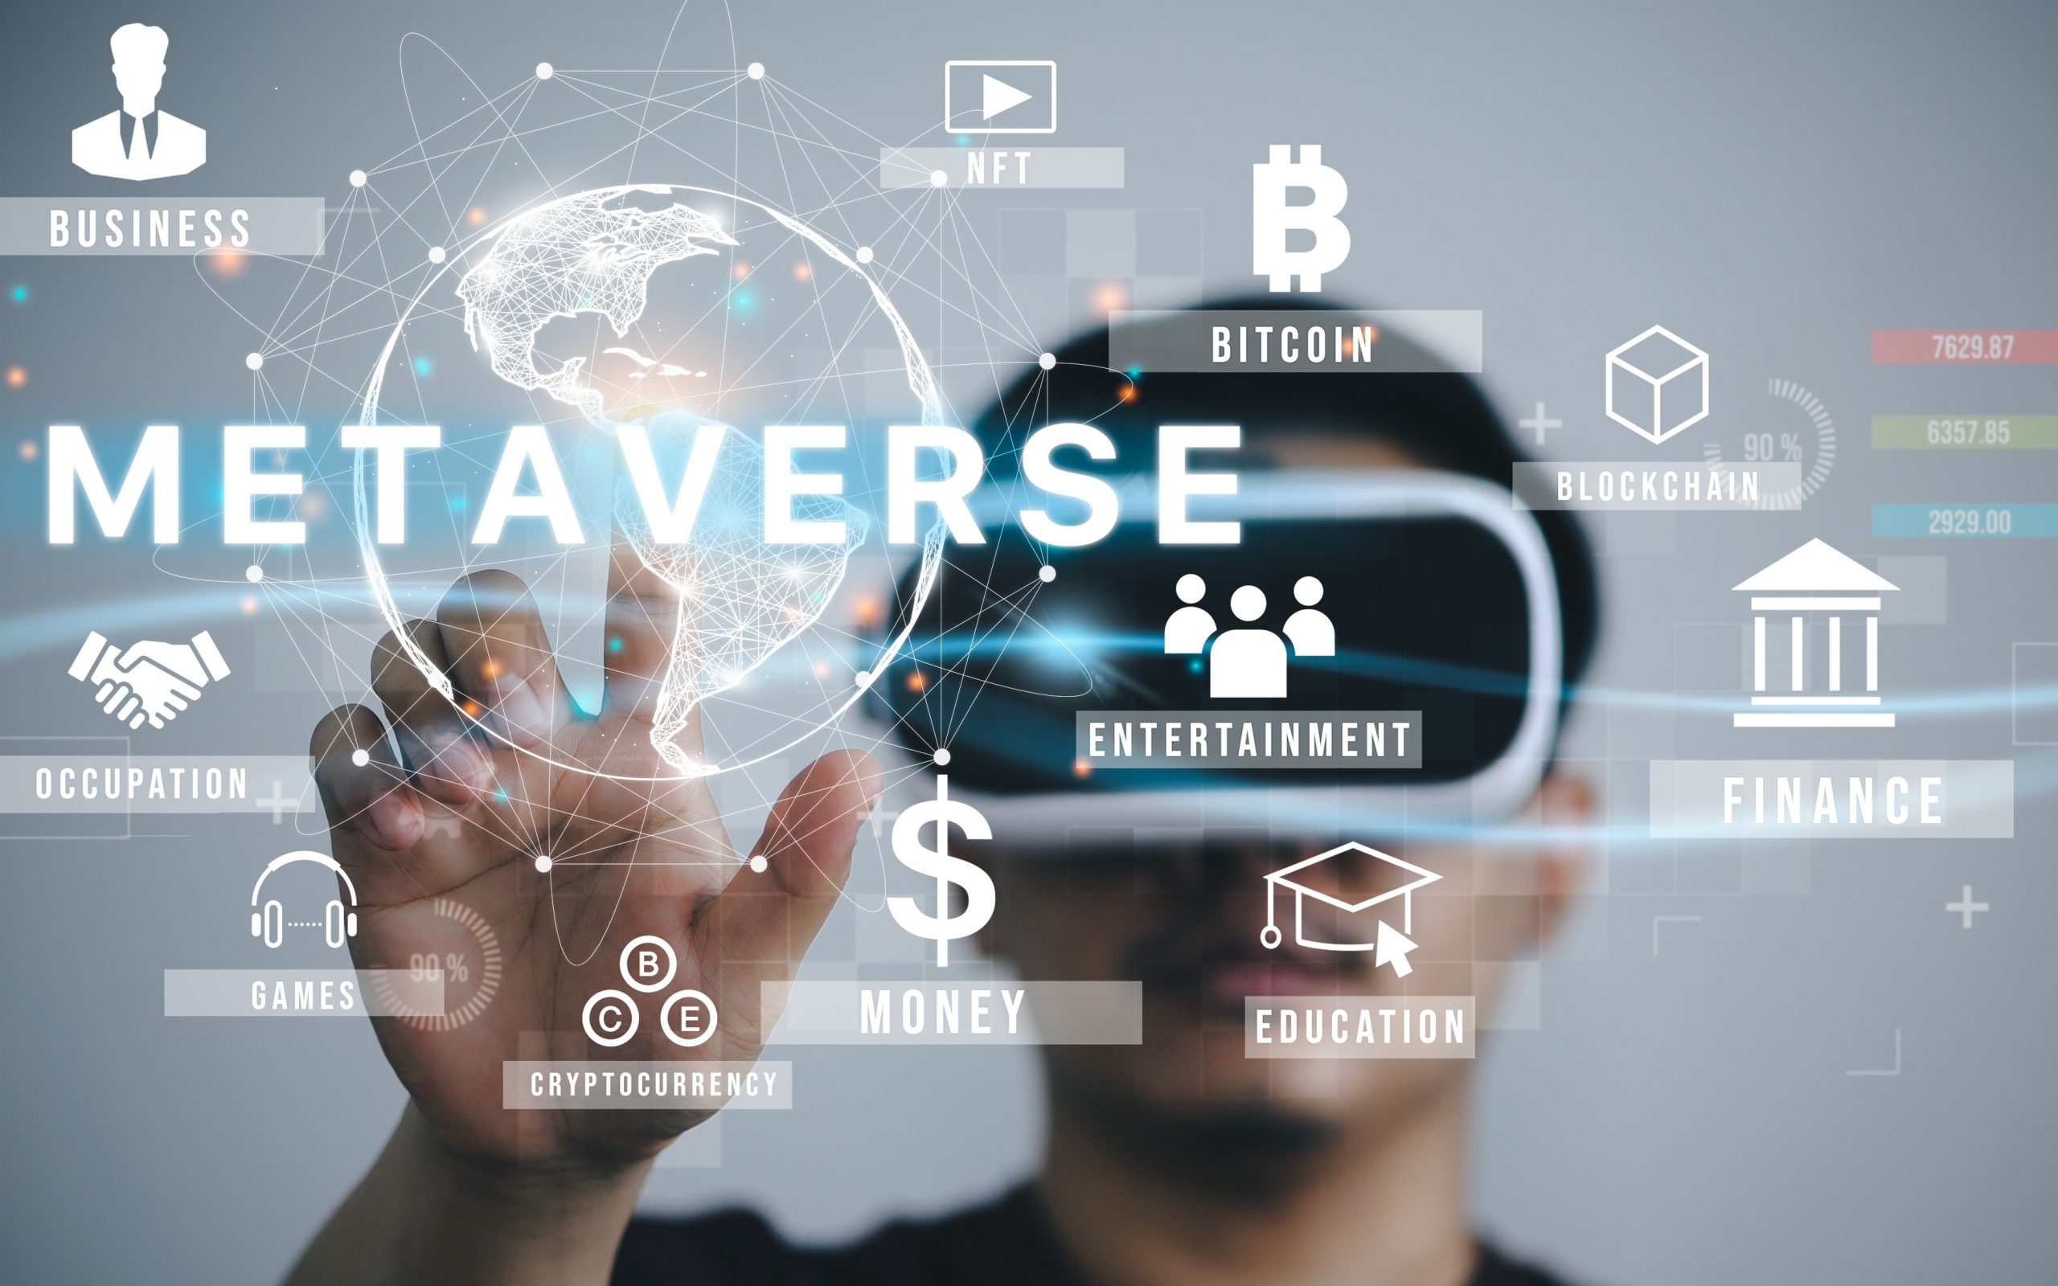
Conclusion of metaverse
Metaverse is still in its nascent stages. It is unclear how long it will take to be fully developed or to what extent it will be able to replicate real life. However, one certain thing is that it has the potential to be the next revolution in the virtual reality world
Notes:
In Slide Show mode, select the arrows to visit links.

Slide 10
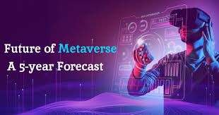
Metaverse expectation
Metaverse allows you to access a 3D Internet where things take place. This opens the door to thousands of applications ranging from video games to remote working, socializing, performances, and communication.

